Slide 1















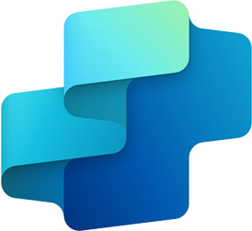





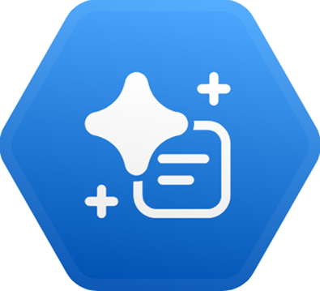
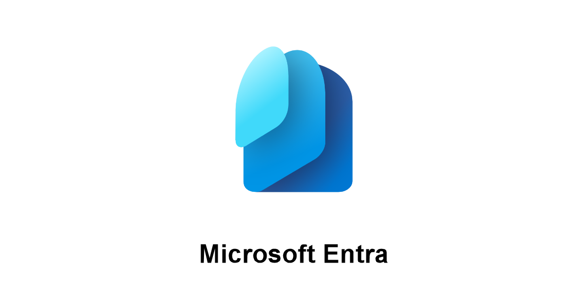


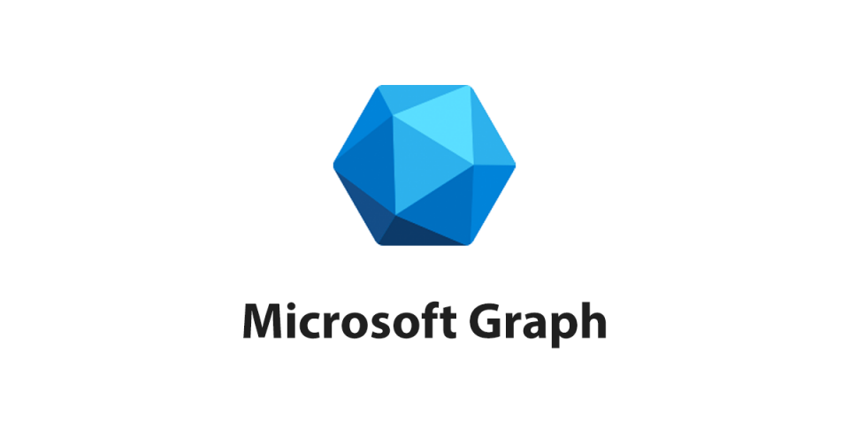








The Security Context of AI Agents’ Interactions with Microsoft Security Tools
MS Security Tool
AI Environments
AI Agents
Main UIs
SOC Personas
(simplified)
Security Copilot
MCP Servers
MCP "Native" Support
in AI Environments
(Existing and Upcoming)
Agent Orchestrators
Development
Environment
Expected
Tool Preference
MS Defender
Agent Creation
Toolset
LLM
VS Code
GitHub Copilot
Triage
Toolset
[*]
[*]
Microsoft Foundry
Develop and publish
For Partners selling in the MS ecosystem
Solution Developer
Sentinel SIEM
[*]
LLM
Other channels
Custom
Toolsets
Workflow
Data Mirroring and Ingestion
Custom Agent(s)
Data Exploration
Toolset
Copilot Studio
MS Teams
Agent
Flow
LLM
Sentinel
Data Lake
Entity Analyzer
Tool
SOC Operator
Custom Agent(s)
LLM
Copilot Chat
Alerts
Security Copilot
LLM
MS Purview
Sentinel
MCP Server
[*]
[*]
Custom Agent(s)
LLM
Security Copilot
Power Automate
SOC Manager
MS Entra
Flow
Plug-ins
[**]
Partner Agents
Graph API
Microsoft Azure
Logic App
MS Defender
MS Security Store
[*]
MCP Server for Enterprise
LLM
LLM
1st Party and Partner Agents
MS Intune
Plug-ins
Connectors
Sentinel
MCP Server
ChatGPT Enterprise
LLM in Azure
Security Copilot
[*]: Not available today; expected to arrive in the future
MCP Server for Enterprise
Claude.AI
[**]: Integration available today only for 1st party and partner agents, not for custom agents
(…)
Up to date as of Jan. 17, 2026 – This is not official Microsoft content: please check for accuracy and completeness!

